Slide 1


Slide 2
DEEP LEARNING COURSE
FALL 2024
Usman Khan, PhD

Slide 3
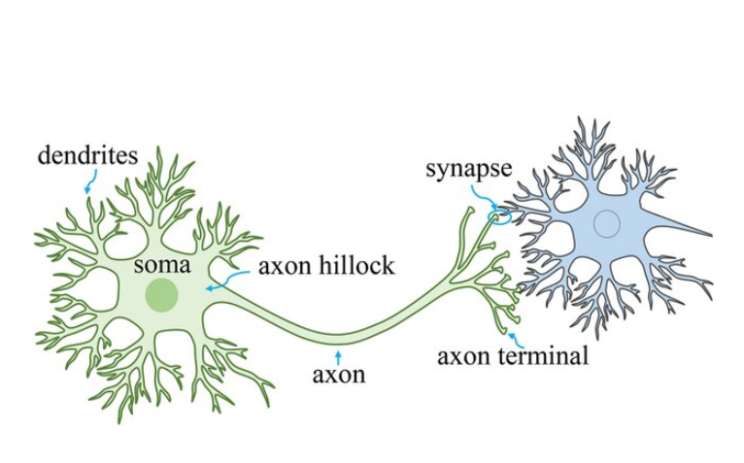
BIOLOGICAL NEURONS
Biological Neurons are composed of a cell body containing the nucleus and most of the cell’s complex components, many branching extensions called dendrites, plus one very long extension called the axon.
The axon’s length may be just a few times longer than the cell body, or up to tens of thousands of times longer. Near Its extremity the axon splits off into many branches called telodendria, and at the tip of these branches are minuscule structures called synaptic terminals (or simply synapses), which are connected to the dendrites or cell bodies of other neurons.
Biological neurons produce short electrical impulses called action potentials (APs, or just signals) which travel along the axons and make the synapses release chemical signals called neurotransmitters
When a neuron receives a sufficient amount of these neurotransmitters within a few milliseconds, it fires its own electrical impulses
Notes:
Axon: The axon is a long, slender projection of the neuron that transmits electrical signals (known as action potentials) away from the cell body (soma) to other neurons, muscles, or glands. Axons can be covered by a myelin sheath, which helps speed up signal transmission.
Soma (Cell Body): The soma is the central part of the neuron that contains the nucleus and other organelles responsible for maintaining the cell's health. It processes incoming signals received from other neurons through the dendrites and integrates them to decide whether to trigger an action potential, which will then be sent down the axon.
Dendrites are the branch-like extensions of a neuron that primarily function to receive signals from other neurons and transmit those signals to the soma (cell body). They act as the input structures of the neuron, collecting electrical and chemical signals from the synapses (junctions between neurons) and relaying them to the cell body for processing.
In summary, dendrites are responsible for:
Receiving signals from other neurons.
Transmitting these signals to the neuron’s cell body (soma) for processing.
Dendrites play a key role in neural communication and the overall function of the nervous system by enabling neurons to interact and form complex networks.

Slide 4
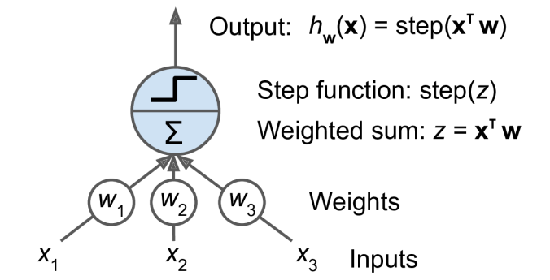
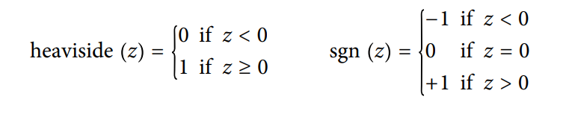
ARTIFICIAL NEURAL NETWORKS & PERCEPTRON
The Perceptron is one of the simplest ANN architectures, invented in 1957 by Frank Rosenblatt. It is based on a slightly different artificial neuron called a threshold logic unit (TLU), or sometimes a linear threshold unit (LTU). The inputs and output are numbers (instead of binary on/off values), and each input connection is associated with a weight. The TLU computes a weighted sum of its inputs (z = w1 x1 + w2 x2 + ⋯ + wn xn = x⊺ w), then applies a step function to that sum and outputs the result: h w(x) = step(z), where z = x⊺ w
Common Step Functions in Perceptron

Slide 5
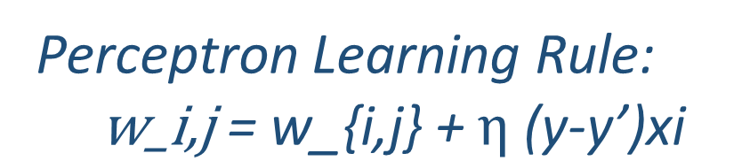
ARTIFICIAL NEURAL NETWORKS & PERCEPTRON
So, how is a Perceptron trained? The Perceptron training algorithm proposed by Rosenblatt was largely inspired by Hebb’s rule. In his 1949 book The Organization of Behavior (Wiley), Donald Hebb suggested that when a biological neuron triggers another neuron often, the connection between these two neurons grows stronger. Sie‐ grid Löwel later summarized Hebb’s idea in the catchy phrase, “Cells that fire together, wire together”; that is, the connection weight between two neurons tends to increase when they fire simultaneously. This rule later became known as Hebb’s rule (or Hebbian learning).
In this equation:
• w i, j is the connection weight between the ith input neuron and the jth output
neuron.
• x i is the ith input value of the current training instance.
• y jis the output of the jth output neuron for the current training instance.
• yj is the target output of the jth output neuron for the current training instance.
• η is the learning rate.
Perceptron Learning Rule:
$$\text{w}\text{_}\text{i}\text{,}\text{j}\text{ = }\text{w}\text{_\{}\text{i}\text{,}\text{j}\text{\} + }η\text{ (}\text{y}\text{−}\text{y}\text{’)}\text{xi}$$

Slide 6
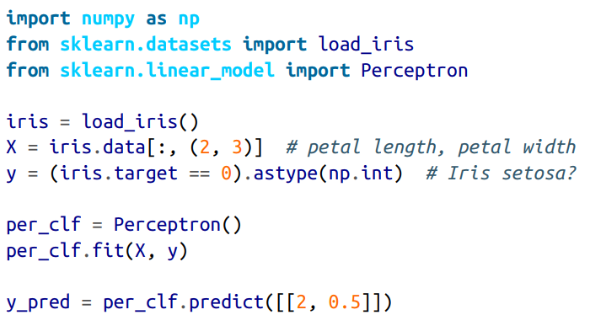
ARTIFICIAL NEURAL NETWORKS & PERCEPTRON
Limitations of Peceptron
Scikit Learn Example – LAB 1
In their 1969 monograph Perceptrons, Marvin Minsky and Seymour Papert highlighted a number of serious weaknesses of Perceptrons—in particular, the fact that they are incapable of solving some trivial problems (e.g., the Exclusive OR (XOR) classification problem

Slide 7
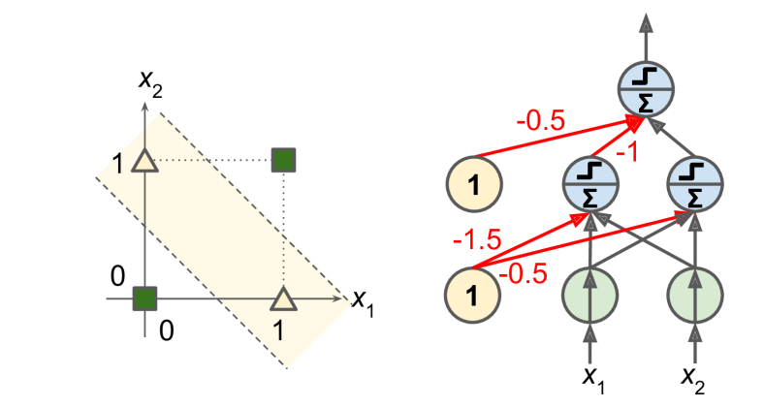
ARTIFICIAL NEURAL NETWORKS & PERCEPTRON
Limitations of Peceptron
It turns out that some of the limitations of Perceptrons can be eliminated by stacking multiple Perceptrons. The resulting ANN is called a Multilayer Perceptron (MLP). An MLP can solve the XOR problem
With inputs (0, 0) or (1, 1), the network outputs 0, and with inputs (0, 1) or (1, 0) it outputs 1. All connections have a weight equal to 1, except the four connections where the weight is shown
Home Work - 1

Slide 8
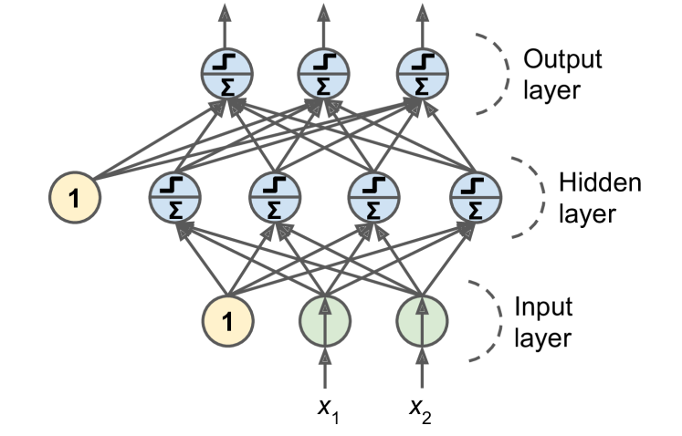
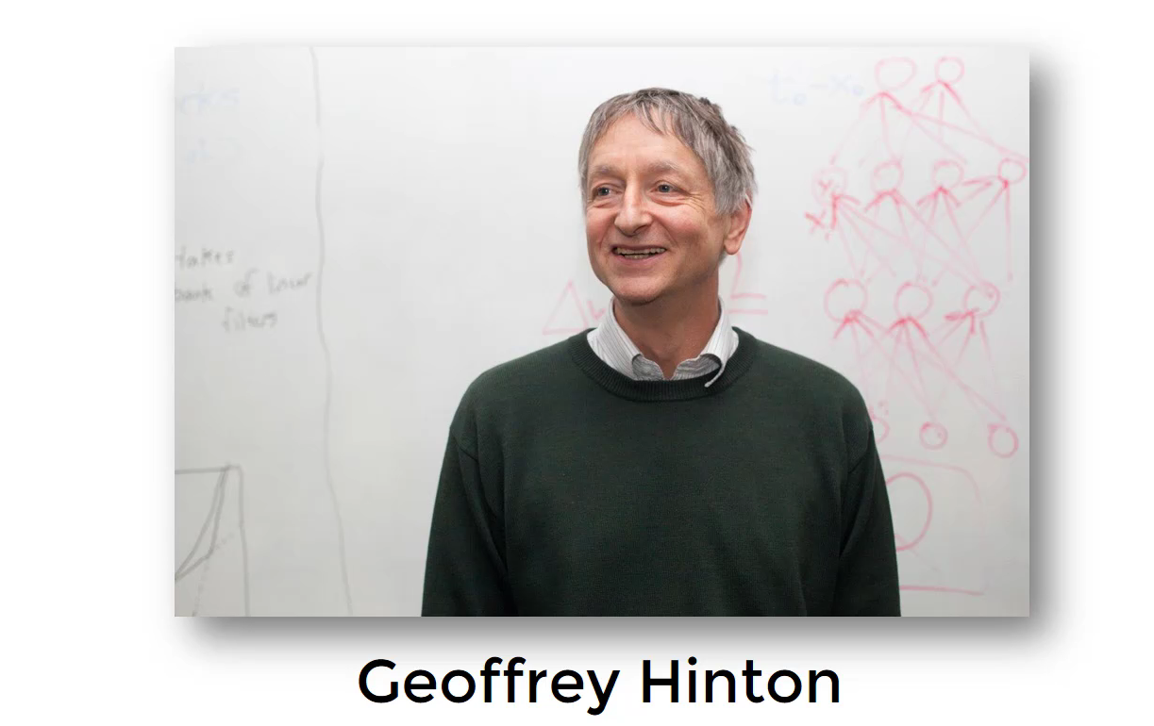
MULTI LAYER PERCEPTRONS WITH FEED FORWARD CONNECTION
When an ANN contains a deep stack of hidden layers,9 it is called a deep neural net‐ work (DNN). The field of Deep Learning studies DNNs, and more generally models containing deep stacks of computations.
In 1986, David Rumelhart, Geoffrey Hinton, and Ronald Williams published a groundbreaking paper that introduced the backpropagation training algorithm, which is still used today. In short, it is Gradient Descent using an efficient technique for computing the gradients automatically. In just two passes through the network (one forward, one backward), the backpropagation algorithm is able to compute the gradient of the network’s error with regard to every single model parameter

Slide 9
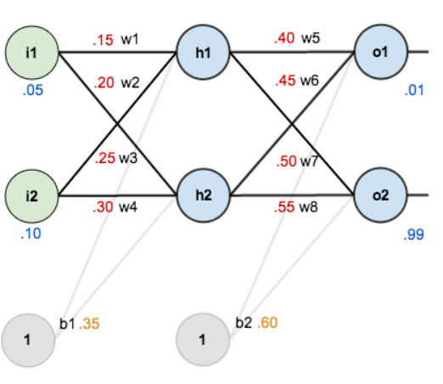
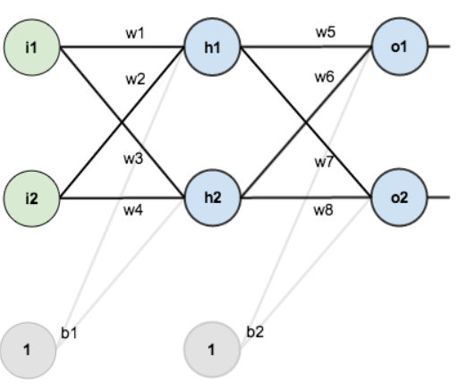
UNDERSTANDING BACK PROPAGATION
Random Initialization of wts & Biases

Slide 10
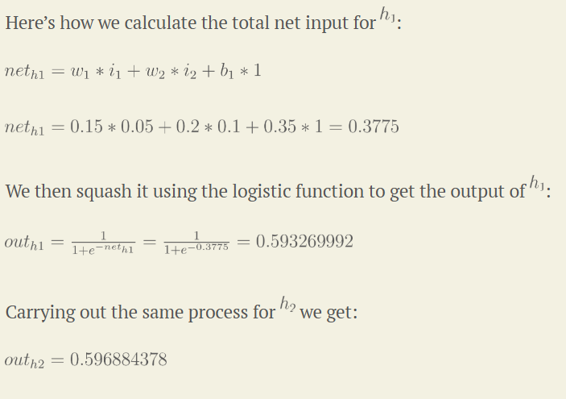
UNDERSTANDING BACK PROPAGATION

Slide 11
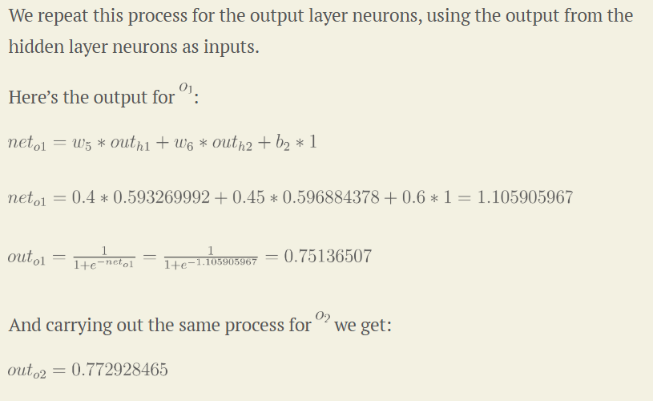
UNDERSTANDING BACK PROPAGATION

Slide 12
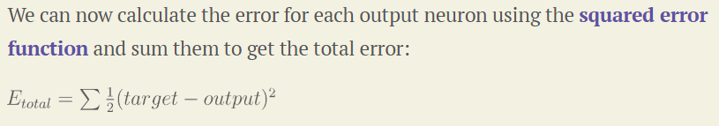
UNDERSTANDING BACK PROPAGATION

Slide 13
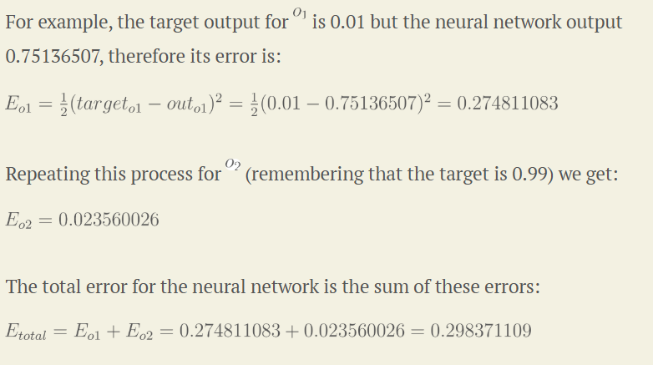
UNDERSTANDING BACK PROPAGATION

Slide 14
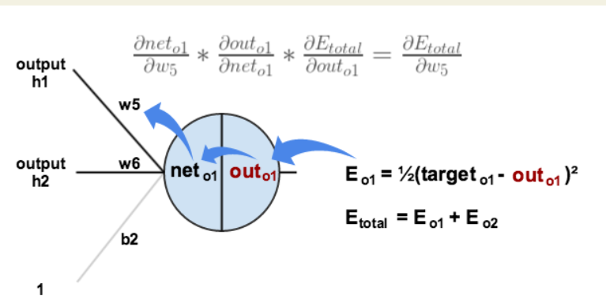
UNDERSTANDING BACK PROPAGATION

Slide 15
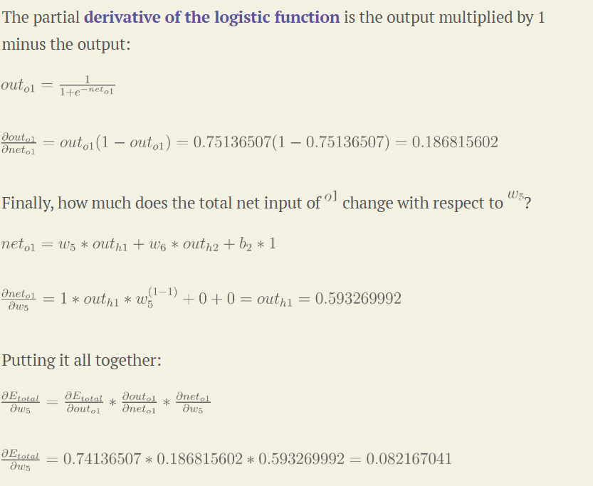
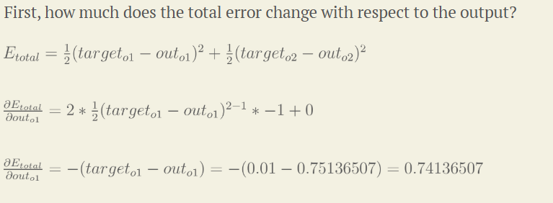
UNDERSTANDING BACK PROPAGATION

Slide 16
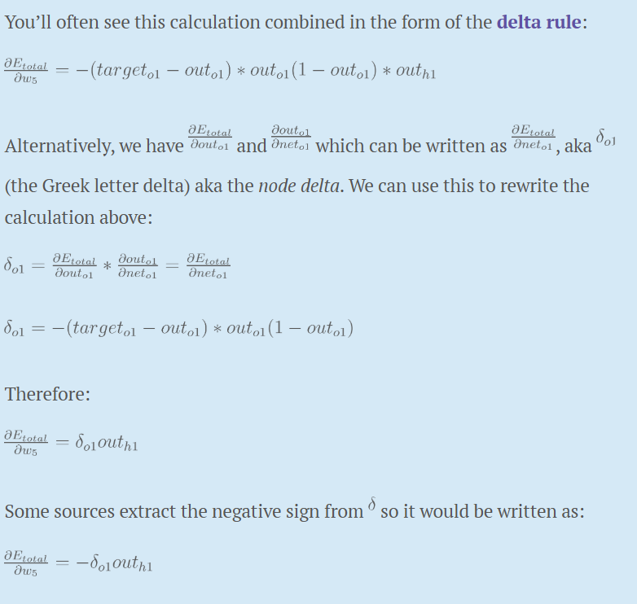
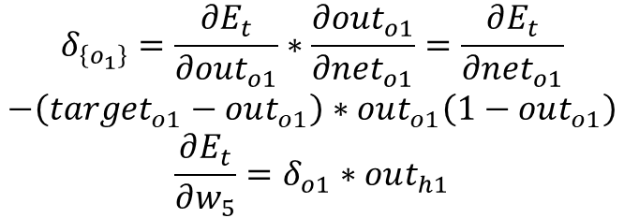
UNDERSTANDING BACK PROPAGATION
DELTA RULE
$$δ_{\left\{o_{1}\right\}}=\frac{∂E_{t}}{∂out_{o1}}∗\frac{∂out_{o1}}{∂net_{o1}}=\frac{∂E_{t}}{∂net_{o1}}$$
$$−\left(target_{o1}−out_{o1}\right)∗out_{o1}\left(1−out_{o1}\right)$$
$$\frac{∂E_{t}}{∂w_{5}}=δ_{o1}∗out_{h1}$$

Slide 17
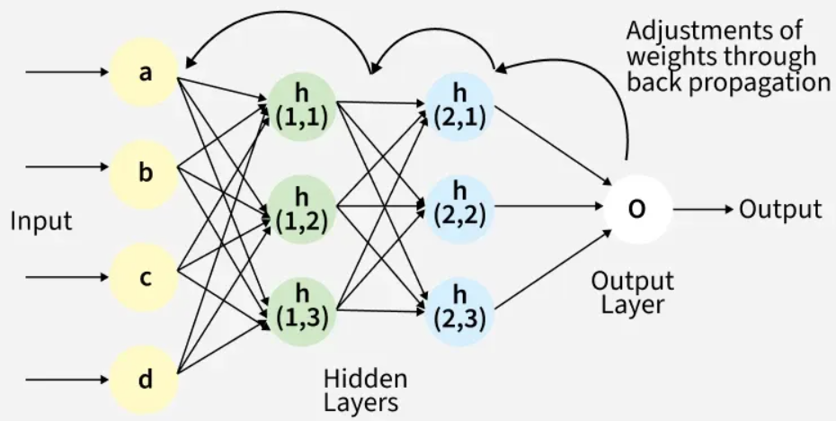
UNDERSTANDING BACK PROPAGATION

Slide 18
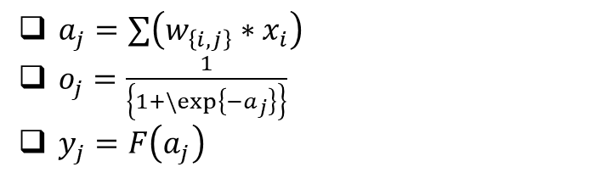
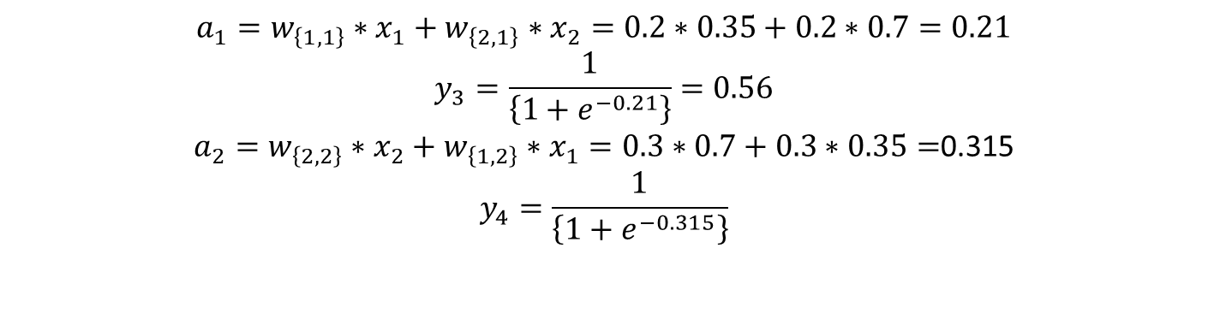
UNDERSTANDING BACK PROPAGATION
Y-3
W1,1 = 0.2
H_1
X_1 = 0.35
W1,3 = 0.3
O_3
W2,1 = 0.2
W1,2 = 0.3
H_2
X_2 = 0.7
W2,3 = 0.9
W2,2 = 0.3
Y-4
$a_{j}=∑\left(w_{\left\{i,j\right\}}∗x_{i}\right)$
$o_{j}=\frac{1}{\left\{1+\backslash exp\left\{−a_{j}\right\}\right\}}$
$y_{j}=F\left(a_{j}\right)$
$$a_{1}=w_{\left\{1,1\right\}}∗x_{1}+w_{\left\{2,1\right\}}∗x_{2}=0.2∗0.35+0.2∗0.7=0.21$$
$$y_{3}=\frac{1}{\left\{1+e^{−0.21}\right\}}=0.56$$
$a_{2}=w_{\left\{2,2\right\}}∗x_{2}+w_{\left\{1,2\right\}}∗x_{1}=0.3∗0.7+0.3∗0.35=$0.315
$$y_{4}=\frac{1}{\left\{1+e^{−0.315}\right\}}$$

Slide 19
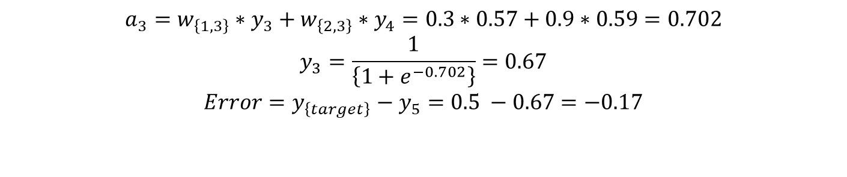
UNDERSTANDING BACK PROPAGATION
Y-3
W1,1 = 0.2
H_1
X_1 = 0.35
W1,3 = 0.3
O_3
W2,1 = 0.2
W1,2 = 0.3
H_2
X_2 = 0.7
W2,3 = 0.9
W2,2 = 0.3
Y-4
$a_{j}=∑\left(w_{\left\{i,j\right\}}∗x_{i}\right)$
$o_{j}=\frac{1}{\left\{1+\backslash exp\left\{−a_{j}\right\}\right\}}$
$y_{j}=F\left(a_{j}\right)$
$$a_{3}=w_{\left\{1,3\right\}}∗y_{3}+w_{\left\{2,3\right\}}∗y_{4}=0.3∗0.57+0.9∗0.59=0.702$$
$$y_{3}=\frac{1}{\left\{1+e^{−0.702}\right\}}=0.67$$
$$Error=y_{\left\{target\right\}}−y_{5}=0.5 −0.67=−0.17$$

Slide 20

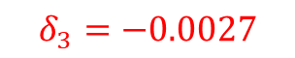
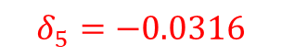
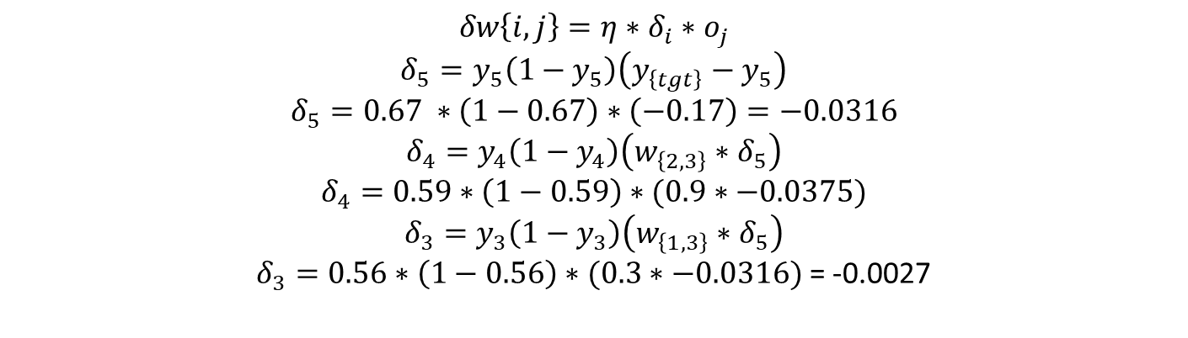
UNDERSTANDING BACK PROPAGATION
Y-3
$$δ_{3}=−0.0027$$
W1,1 = 0.2
H_1
X_1 = 0.35
W1,3 = 0.3
$$δ_{5}=−0.0316$$
O_3
W2,1 = 0.2
$$δ_{4}$$
W1,2 = 0.3
H_2
X_2 = 0.7
W2,3 = 0.9
W2,2 = 0.3
Y-4
$a_{j}=∑\left(w_{\left\{i,j\right\}}∗x_{i}\right)$
$o_{j}=\frac{1}{\left\{1+\backslash exp\left\{−a_{j}\right\}\right\}}$
$y_{j}=F\left(a_{j}\right)$
$$δw\left\{i,j\right\}=η∗δ_{i}∗o_{j}$$
$$δ_{5}=y_{5}\left(1−y_{5}\right)\left(y_{\left\{tgt\right\}}−y_{5}\right)$$
$$δ_{5}=0.67 ∗\left(1−0.67\right)∗\left(−0.17\right)=−0.0316$$
$$δ_{4}=y_{4}\left(1−y_{4}\right)\left(w_{\left\{2,3\right\}}∗δ_{5}\right)$$
$$δ_{4}=0.59∗\left(1−0.59\right)∗(0.9∗−0.0375)$$
$$δ_{3}=y_{3}\left(1−y_{3}\right)\left(w_{\left\{1,3\right\}}∗δ_{5}\right)$$
$δ_{3}=0.56∗\left(1−0.56\right)∗(0.3∗−0.0316)$ = -0.0027

Slide 21
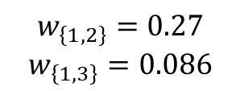
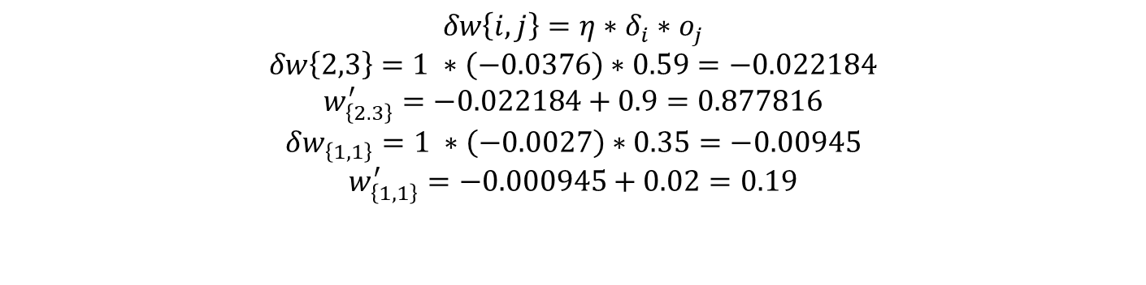
UNDERSTANDING BACK PROPAGATION
Y-3
W’1,1 = 0.19
H_1
X_1 = 0.35
W1,3 = 0.3
O_3
W2,1 = 0.2
W1,2 = 0.3
H_2
X_2 = 0.7
W’2,3 = 0.877816
W2,2 = 0.3
Y-4
Similarly,
$a_{j}=∑\left(w_{\left\{i,j\right\}}∗x_{i}\right)$
$o_{j}=\frac{1}{\left\{1+\backslash exp\left\{−a_{j}\right\}\right\}}$
$y_{j}=F\left(a_{j}\right)$
$$δw\left\{i,j\right\}=η∗δ_{i}∗o_{j}$$
$$δw\left\{2,3\right\}=1 ∗\left(−0.0376\right)∗0.59=−0.022184$$
$$w_{\left\{2.3\right\}}^{′}=−0.022184+0.9=0.877816$$
$$δw_{\left\{1,1\right\}}=1 ∗\left(−0.0027\right)∗0.35=−0.00945$$
$$w_{\left\{1,1\right\}}^{′}=−0.000945+0.02=0.19$$
$$w_{\left\{1,2\right\}}=0.27$$
$$w_{\left\{1,3\right\}}=0.086$$

Slide 22
UNDERSTANDING GRADIENT DESCENT
• Gradient Descent Optimization
• Central Difference Numerical Derivative
• Function: f(x)=x²+4x+4
• Optimal Solution: x = -2
Mathematical Idea:
f'(x) ≈ (f(x+h)-f(x-h))/(2h)
This algorithm is so important that it’s worth summarizing it again: for each training instance, the backpropagation algorithm first makes a prediction (forward pass) and measures the error, then goes through each layer in reverse to measure the error con‐ tribution from each connection (reverse pass), and finally tweaks the connection weights to reduce the error.
Notes:
Reinforcement learning (RL) is a type of machine learning where an agent learns to make decisions by interacting with an environment. The agent takes actions in the environment, receives feedback in the form of rewards or penalties, and uses this feedback to improve its future decisions. The goal is for the agent to learn a policy (a strategy of action selection) that maximizes the cumulative reward over time.
Key components of reinforcement learning include:
Agent: The learner or decision-maker.
Environment: The external system the agent interacts with.
State: A representation of the current situation of the environment.
Action: The set of possible moves the agent can make.
Reward: Feedback from the environment to evaluate actions (positive for good actions, negative for bad ones).
Policy: A strategy used by the agent to determine the next action based on the current state.
Value Function: A prediction of the long-term reward for a given state (or state-action pair).
Reinforcement learning is often applied in areas like robotics, game playing, autonomous driving, and recommendation systems.
4o
Example: Training an agent to play chess
Agent: The chess-playing AI.
Environment: The chess board and game rules.
State: The current configuration of the chessboard (i.e., where all the pieces are located).
Action: The possible moves the agent can make (e.g., moving a pawn, knight, or other pieces).
Reward:
Positive reward for achieving a goal (like capturing an opponent's piece or winning the game).
Negative reward for making a bad move (like losing a piece or getting checkmated).
No immediate reward for intermediate moves, but the final result (win, lose, or draw) greatly impacts cumulative rewards.
Policy: The strategy the agent uses to decide which move to make based on the current state of the board.
Training Process:
The agent starts by playing games randomly, making random moves. It learns from each game's outcome (win or loss).
After many games, it starts to identify patterns of moves that lead to better outcomes, adjusting its actions to maximize the chances of winning.
Over time, it improves its policy by optimizing moves based on long-term rewards, learning the value of board positions and actions that will increase the probability of victory.
Example in Action:
Initial game: The agent might sacrifice a valuable piece like a queen early in the game and lose.
Learning: Over many games, it realizes that preserving the queen increases its chances of winning in the long run.
Improvement: The agent now avoids unnecessary sacrifices and plays more strategically to improve its performance.
This is how reinforcement learning allows an agent to progressively learn an optimal strategy through trial and error by maximizing rewards and minimizing penalties over time.

Slide 23
UNDERSTANDING GRADIENT DESCENT
int main(){
Gnuplot gp;
double x = 10.0; // Initial guess
double lr = 0.01; // learning rate
double h = 1e-5; // Small step for numerical derivative
int iterations = 1000;
vector<pair<double,double>> path;
double grad;
int option;
cin >> option;
for (int i =0; i < iterations; i++){
switch(option){
case 1:
grad = centralDerivative(x, h);
break;
case 2:
grad = forwardDerivative(x, h);
break;
case 3:
grad = backwardDerivative(x, h);
break;
default:
cout << "Invalid option. Using central difference by default." << endl;
grad = centralDerivative(x, h);
}
x = x - lr * grad;
return 0;
}
double f(double X){
return pow(X,2) + 4*X + 4;
}
double centralDerivative(double x, double h){
return (f(x+h) - f(x-h))/(2*h);
}
double forwardDerivative(double x, double h){
return (f(x+h) - f(x))/h;
}
double backwardDerivative(double x, double h){
return (f(x) - f(x-h))/h;
}
Notes:
Reinforcement learning (RL) is a type of machine learning where an agent learns to make decisions by interacting with an environment. The agent takes actions in the environment, receives feedback in the form of rewards or penalties, and uses this feedback to improve its future decisions. The goal is for the agent to learn a policy (a strategy of action selection) that maximizes the cumulative reward over time.
Key components of reinforcement learning include:
Agent: The learner or decision-maker.
Environment: The external system the agent interacts with.
State: A representation of the current situation of the environment.
Action: The set of possible moves the agent can make.
Reward: Feedback from the environment to evaluate actions (positive for good actions, negative for bad ones).
Policy: A strategy used by the agent to determine the next action based on the current state.
Value Function: A prediction of the long-term reward for a given state (or state-action pair).
Reinforcement learning is often applied in areas like robotics, game playing, autonomous driving, and recommendation systems.
4o
Example: Training an agent to play chess
Agent: The chess-playing AI.
Environment: The chess board and game rules.
State: The current configuration of the chessboard (i.e., where all the pieces are located).
Action: The possible moves the agent can make (e.g., moving a pawn, knight, or other pieces).
Reward:
Positive reward for achieving a goal (like capturing an opponent's piece or winning the game).
Negative reward for making a bad move (like losing a piece or getting checkmated).
No immediate reward for intermediate moves, but the final result (win, lose, or draw) greatly impacts cumulative rewards.
Policy: The strategy the agent uses to decide which move to make based on the current state of the board.
Training Process:
The agent starts by playing games randomly, making random moves. It learns from each game's outcome (win or loss).
After many games, it starts to identify patterns of moves that lead to better outcomes, adjusting its actions to maximize the chances of winning.
Over time, it improves its policy by optimizing moves based on long-term rewards, learning the value of board positions and actions that will increase the probability of victory.
Example in Action:
Initial game: The agent might sacrifice a valuable piece like a queen early in the game and lose.
Learning: Over many games, it realizes that preserving the queen increases its chances of winning in the long run.
Improvement: The agent now avoids unnecessary sacrifices and plays more strategically to improve its performance.
This is how reinforcement learning allows an agent to progressively learn an optimal strategy through trial and error by maximizing rewards and minimizing penalties over time.

Slide 24
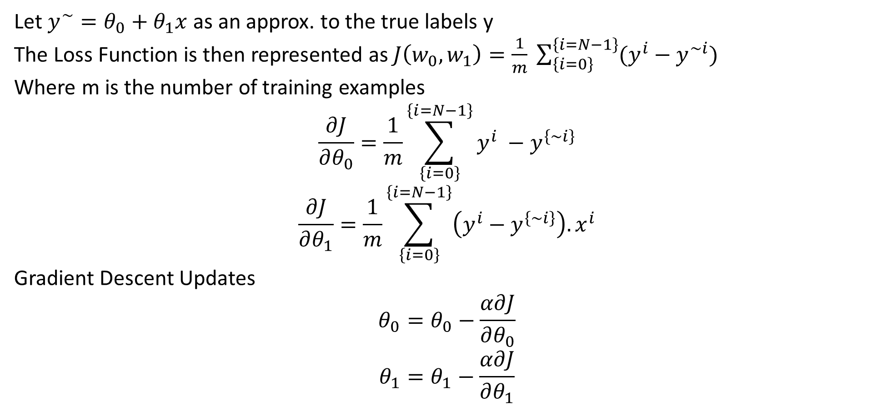
UNDERSTANDING GRADIENT DESCENT
Let $y^{\sim }=θ_{0}+θ_{1}x$ as an approx. to the true labels y
The Loss Function is then represented as $J\left(w_{0},w_{1}\right)=\frac{1}{m} \sum_{\left\{i=0\right\}}^{\left\{i=N−1\right\}}{(y^{i}−y^{\sim i})}$
Where m is the number of training examples
$$\frac{∂J}{∂θ_{0}}=\frac{1}{m}\sum_{\left\{i=0\right\}}^{\left\{i=N−1\right\}}{y^{i} −y^{\left\{\sim i\right\}}}$$
$$\frac{∂J}{∂θ_{1}}=\frac{1}{m}\sum_{\left\{i=0\right\}}^{\left\{i=N−1\right\}}{\left(y^{i}−y^{\left\{\sim i\right\}}\right).x^{i}}$$
Gradient Descent Updates
$$θ_{0}=θ_{0}−\frac{α∂J}{∂θ_{0}}$$
$$θ_{1}=θ_{1}−\frac{α∂J}{∂θ_{1}}$$
Notes:
Reinforcement learning (RL) is a type of machine learning where an agent learns to make decisions by interacting with an environment. The agent takes actions in the environment, receives feedback in the form of rewards or penalties, and uses this feedback to improve its future decisions. The goal is for the agent to learn a policy (a strategy of action selection) that maximizes the cumulative reward over time.
Key components of reinforcement learning include:
Agent: The learner or decision-maker.
Environment: The external system the agent interacts with.
State: A representation of the current situation of the environment.
Action: The set of possible moves the agent can make.
Reward: Feedback from the environment to evaluate actions (positive for good actions, negative for bad ones).
Policy: A strategy used by the agent to determine the next action based on the current state.
Value Function: A prediction of the long-term reward for a given state (or state-action pair).
Reinforcement learning is often applied in areas like robotics, game playing, autonomous driving, and recommendation systems.
4o
Example: Training an agent to play chess
Agent: The chess-playing AI.
Environment: The chess board and game rules.
State: The current configuration of the chessboard (i.e., where all the pieces are located).
Action: The possible moves the agent can make (e.g., moving a pawn, knight, or other pieces).
Reward:
Positive reward for achieving a goal (like capturing an opponent's piece or winning the game).
Negative reward for making a bad move (like losing a piece or getting checkmated).
No immediate reward for intermediate moves, but the final result (win, lose, or draw) greatly impacts cumulative rewards.
Policy: The strategy the agent uses to decide which move to make based on the current state of the board.
Training Process:
The agent starts by playing games randomly, making random moves. It learns from each game's outcome (win or loss).
After many games, it starts to identify patterns of moves that lead to better outcomes, adjusting its actions to maximize the chances of winning.
Over time, it improves its policy by optimizing moves based on long-term rewards, learning the value of board positions and actions that will increase the probability of victory.
Example in Action:
Initial game: The agent might sacrifice a valuable piece like a queen early in the game and lose.
Learning: Over many games, it realizes that preserving the queen increases its chances of winning in the long run.
Improvement: The agent now avoids unnecessary sacrifices and plays more strategically to improve its performance.
This is how reinforcement learning allows an agent to progressively learn an optimal strategy through trial and error by maximizing rewards and minimizing penalties over time.

Slide 25
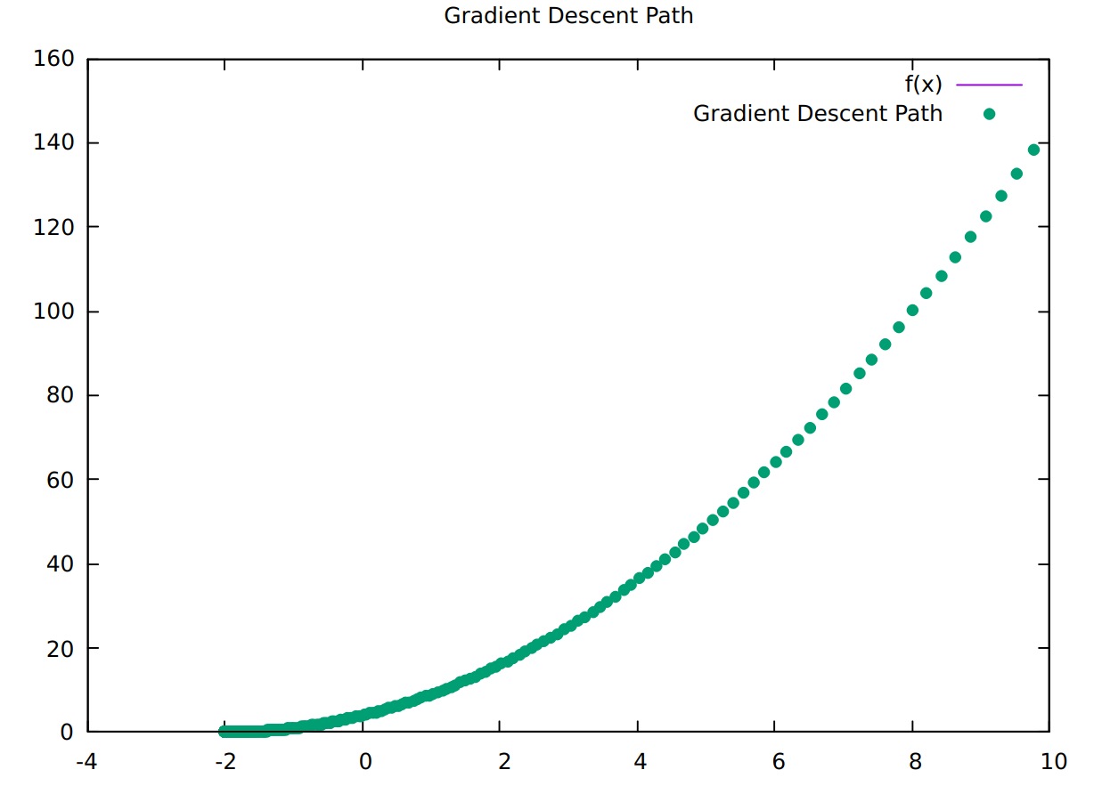
UNDERSTANDING GRADIENT DESCENT
Notes:
Reinforcement learning (RL) is a type of machine learning where an agent learns to make decisions by interacting with an environment. The agent takes actions in the environment, receives feedback in the form of rewards or penalties, and uses this feedback to improve its future decisions. The goal is for the agent to learn a policy (a strategy of action selection) that maximizes the cumulative reward over time.
Key components of reinforcement learning include:
Agent: The learner or decision-maker.
Environment: The external system the agent interacts with.
State: A representation of the current situation of the environment.
Action: The set of possible moves the agent can make.
Reward: Feedback from the environment to evaluate actions (positive for good actions, negative for bad ones).
Policy: A strategy used by the agent to determine the next action based on the current state.
Value Function: A prediction of the long-term reward for a given state (or state-action pair).
Reinforcement learning is often applied in areas like robotics, game playing, autonomous driving, and recommendation systems.
4o
Example: Training an agent to play chess
Agent: The chess-playing AI.
Environment: The chess board and game rules.
State: The current configuration of the chessboard (i.e., where all the pieces are located).
Action: The possible moves the agent can make (e.g., moving a pawn, knight, or other pieces).
Reward:
Positive reward for achieving a goal (like capturing an opponent's piece or winning the game).
Negative reward for making a bad move (like losing a piece or getting checkmated).
No immediate reward for intermediate moves, but the final result (win, lose, or draw) greatly impacts cumulative rewards.
Policy: The strategy the agent uses to decide which move to make based on the current state of the board.
Training Process:
The agent starts by playing games randomly, making random moves. It learns from each game's outcome (win or loss).
After many games, it starts to identify patterns of moves that lead to better outcomes, adjusting its actions to maximize the chances of winning.
Over time, it improves its policy by optimizing moves based on long-term rewards, learning the value of board positions and actions that will increase the probability of victory.
Example in Action:
Initial game: The agent might sacrifice a valuable piece like a queen early in the game and lose.
Learning: Over many games, it realizes that preserving the queen increases its chances of winning in the long run.
Improvement: The agent now avoids unnecessary sacrifices and plays more strategically to improve its performance.
This is how reinforcement learning allows an agent to progressively learn an optimal strategy through trial and error by maximizing rewards and minimizing penalties over time.

Slide 26
NEURONS IN HUMAN BRIAN
Standardize the Inputs
INPUT 1
NEURON
INPUT 2
OUTPUT
INPUT 3
Continuous
Binary
Categorical
Synapse

Slide 27
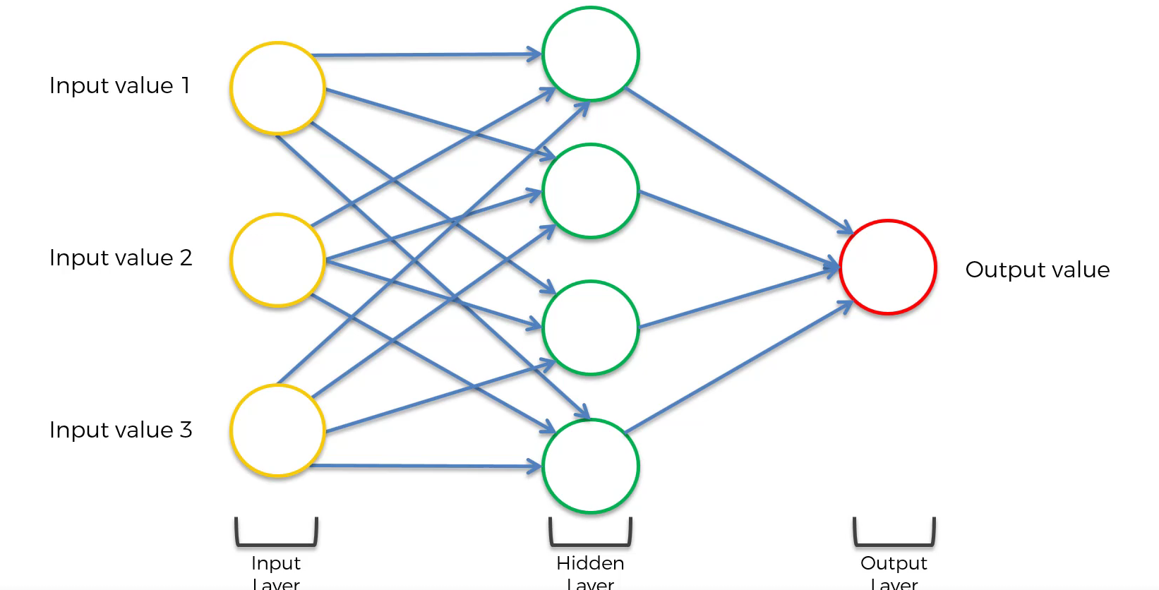
NEURAL NETWORKS

Slide 28
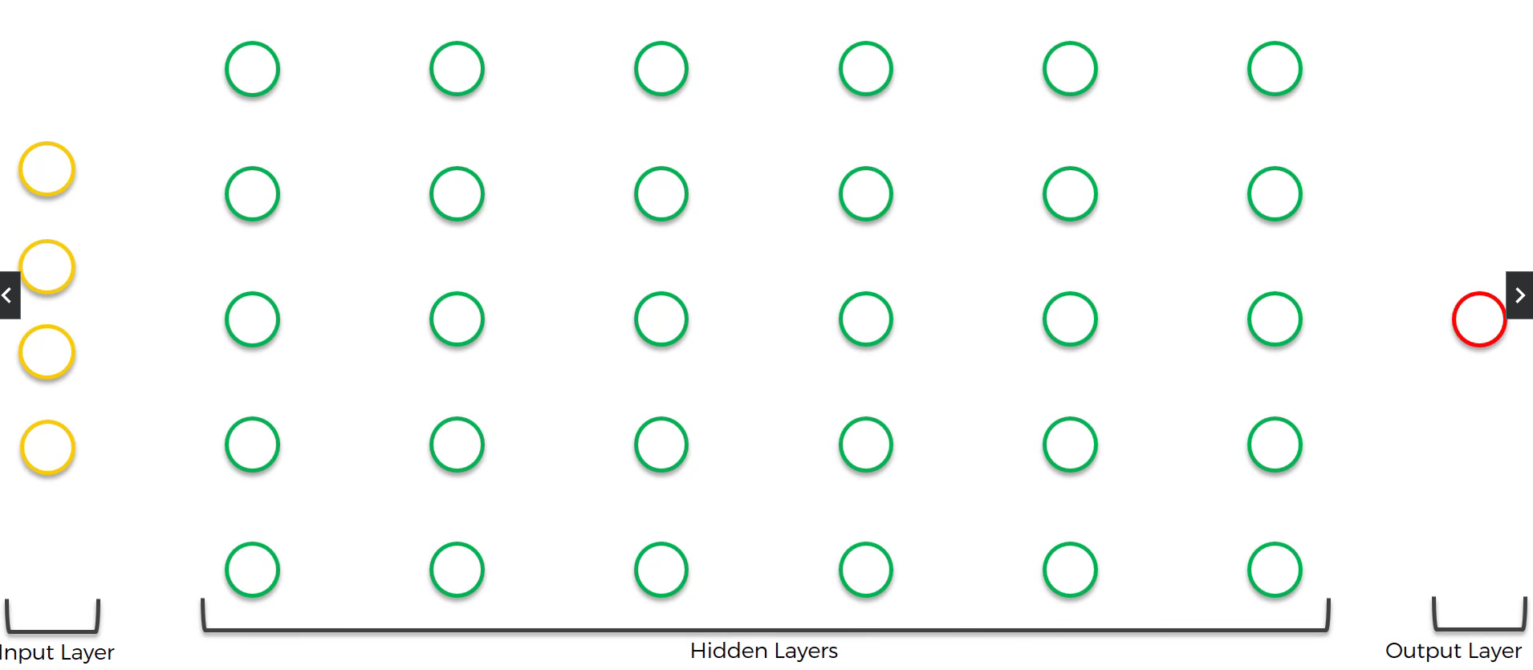
DEEP NETWORKS

Slide 29
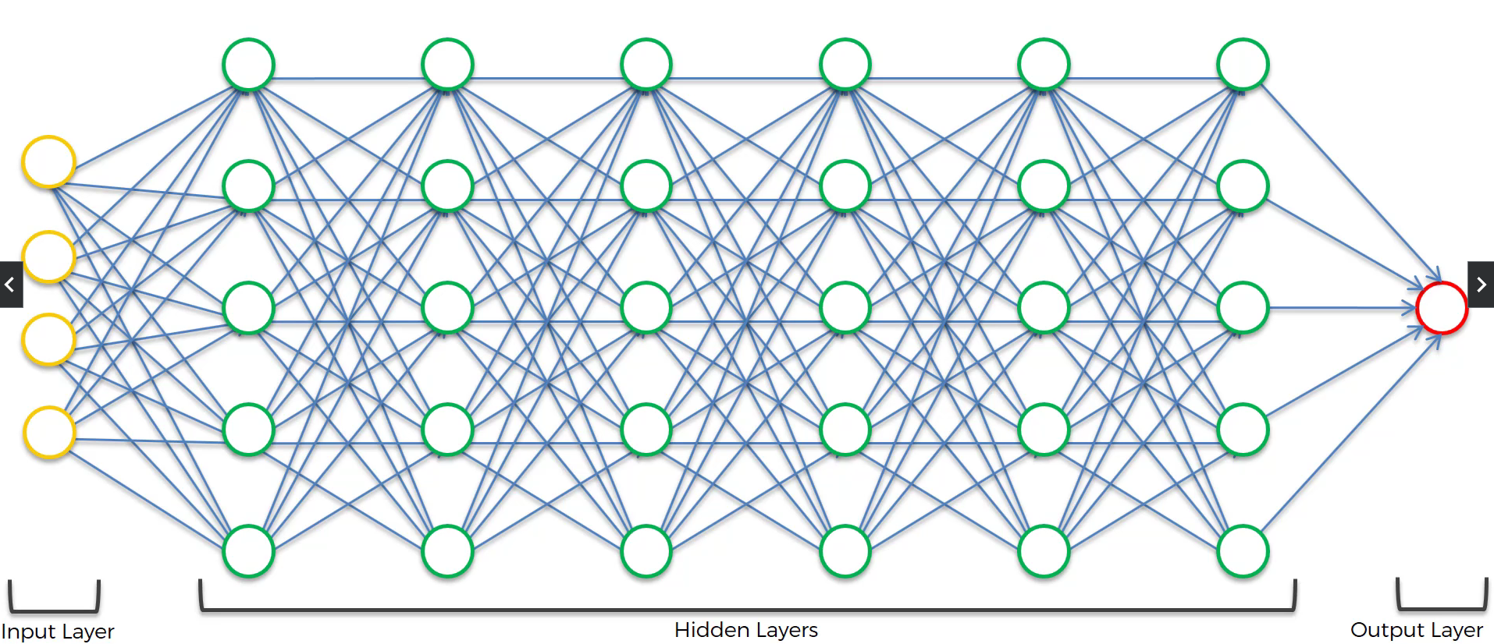
DEEP NETWORKS

Slide 30
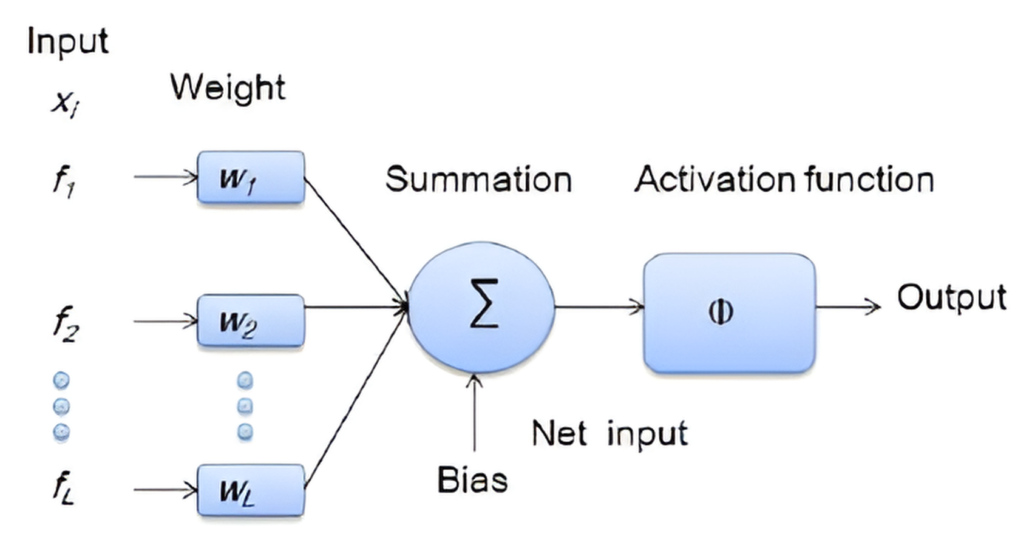
NEURAL NETS
Operation Inside Neuron

Slide 31
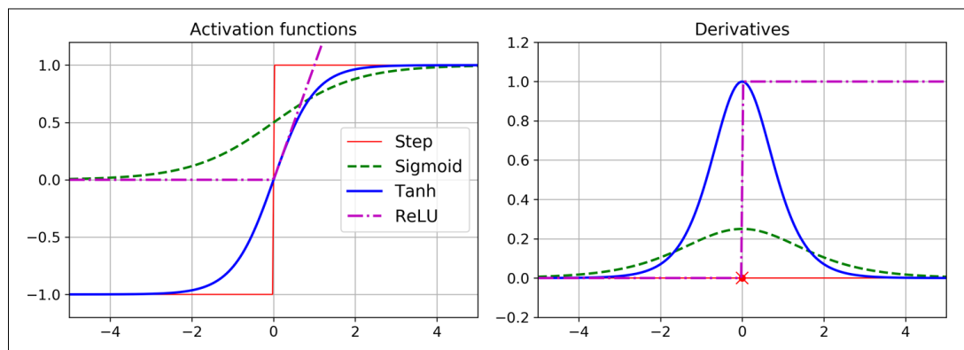
WHY DO WE NEED ACTIVATION FUNCTIONS
If you chain several linear transformations, all you get is a linear transformation. For example, if f(x) = 2x + 3 and g(x) = 5x – 1, then chaining these two linear functions gives you another linear function: f(g(x)) = 2(5x – 1) + 3 = 10x + 1. So if you don’t have some nonlinearity between layers, then even a deep stack of layers is equivalent to a single layer, and you can’t solve very complex problems with that. Conversely, a large enough DNN with nonlinear activations can theoretically approximate any continuous function.

Slide 32
WHY DO WE NEED ACTIVATION FUNCTIONS
MLPs can be used for regression tasks. For example, to locate the center of an object in an image, you need to predict 2D coordinates, so you need two output neurons. If you also want to place a bounding box around the object, then you need two more numbers: the width and the height of the object. So, you end up with four output neurons
When building an MLP for regression, you do not want to use any activation function for the output neurons, so they are free to output any range of values. If you want to guarantee that the output will always be positive, then you can use the ReLU activation function in the output layer. Alternatively, you can use the softplus activation function, which is a smooth variant of ReLU: softplus(z) = log(1 + exp(z)). It is close to 0 when z is negative, and close to z when z is positive
If you want to guarantee that the predictions will fall within a given range of values, then you can use the logistic function or the hyperbolic tangent, and then scale the labels to the appropriate range: 0 to 1 for the logistic function and –1 to 1 for the hyperbolic tangent.

Slide 33
WHY DO WE NEED ACTIVATION FUNCTIONS
The loss function to use during training is typically the mean squared error, but if you have a lot of outliers in the training set, you may prefer to use the mean absolute error instead.
Huber loss is quadratic when the error is smaller than a threshold δ (typically 1) but linear when the error is larger than δ. The linear part makes it less sensitive to outliers than the mean squared error, and the quadratic part allows it to converge faster and be more precise than the mean absolute error.
MLPs can also be used for classification tasks. For a binary classification problem, you just need a single output neuron using the logistic activation function: the output will be a number between 0 and 1, which you can interpret as the estimated probability of the positive class.
The softmax function will ensure that all the estimated probabilities are between 0 and 1 and that they add up to 1. This is called multiclass classification.

